Slide 1
Connecticut State Grange 7th LECTURERS’ ROUNDUP
Sunday, September 17, 2023
7:00 PM

Slide 2
Our Agenda
Welcome by CT State Grange Lecturer Dave Roberts
Brief attendee introductions
Hearing awareness project update
“The State Grange Plot” update
2023 State Lecturer Contests
Updates from Community/Pomona Grange Lecturers
Other items you want to discuss?
Adjourn

Slide 3
Brief Attendee introductions
Name
Grange
Position

Slide 4
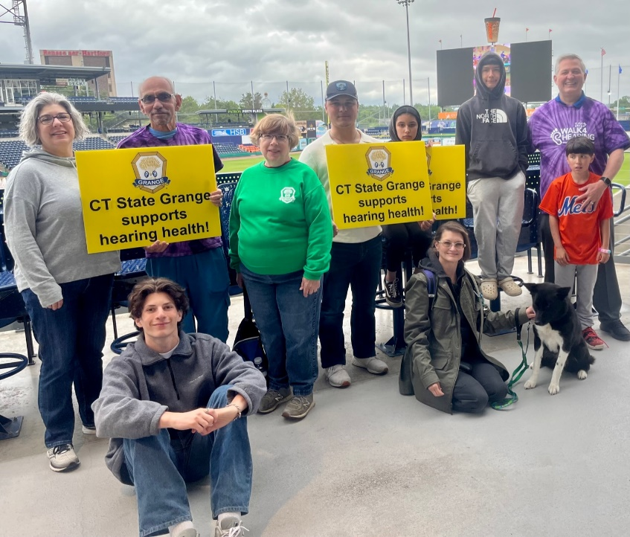
Deaf Awareness
Five Granges participated in Walk4Hearing at Dunkin Stadium (12 walkers) and raised over $850 for American School for the Deaf.
Connecticut State Grange Lecturer’s Dept. received $1,000 National Grange Foundation Grant to promote deaf awareness.

Slide 5
Monday, October 30th ^{6:00 – 7:00 PM}

Slide 6
Tuesday, October 31st 1:30 – 2:30 PM

Slide 7
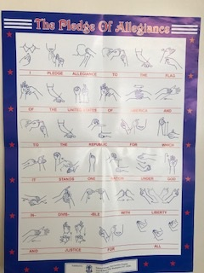
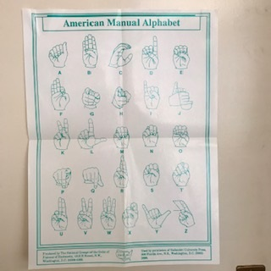
Sign Language Posters

Slide 8
The State Grange Plot

Slide 9
One clue: Bicentennial Program

Slide 10
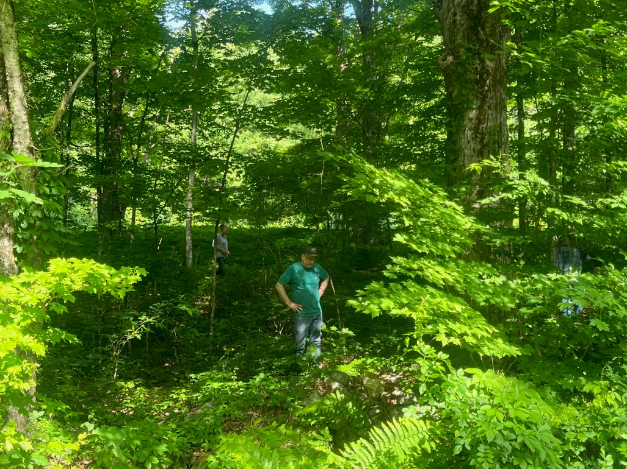
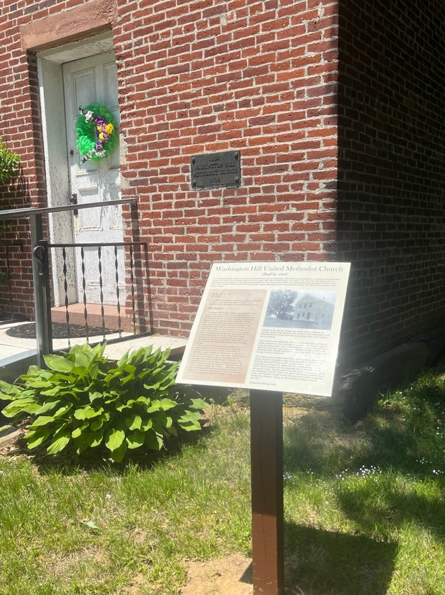
The State Grange Plot Today
Add name to FALPS map
Add signage on property

Slide 13
LECTURER’S APPRECIATION AWARD
(In 2021-2022, seven Granges earned this award!)
CRITERIA for Community and Pomona Granges:
1. Be responsible for a suitable program at every meeting.
2. Programs should be as appropriate up to 30 minutes in length.
3. Cooperate with your Grange Committees.
4. Reports to the State Grange Lecturer/Program Director should be submitted in a timely manner.
5. Submit a request to the Connecticut State Grange Lecturer not later than September 30th that your Grange Lecturer has qualified for this award.

Slide 14
HONOR LECTURER AWARD
(In 2021-2022, six Granges earned this award!)
CRITERIA for Community and Pomona Granges:
Meet requirements for the Lecturer’s Appreciation Award.
Participate in at least 3 additional contests or projects (Heirloom, Photo, Complete, “Honoring Our Elders”, “A Word from Home”, or “Initiate a New Program”.
Submit a Grange in Action or a Golden Grange in Action nomination to National Grange and copy the Connecticut State Grange Lecturer.
Submit a request to the Connecticut State Grange Lecturer not later than September 30th that your Grange Lecturer has qualified for this award.

Slide 15
Updates from Community/Pomona Grange Lecturers
Successes
Challenges
Other items to discuss?
Questions?

Slide 16
Thank you for joining us tonight!

